Slide 2

1
5
Lesson 15
Solid Geometry I-
Surface Area and Volume

Slide 3
Part 1
Vertices, Edges and Faces

Slide 4

Lead in

Slide 5

Example

Slide 6
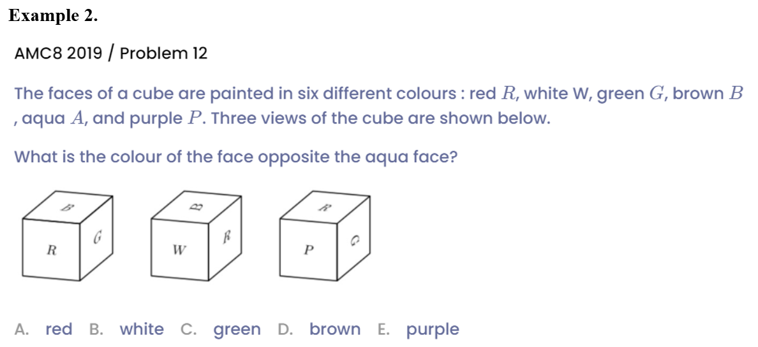
Example

Slide 7
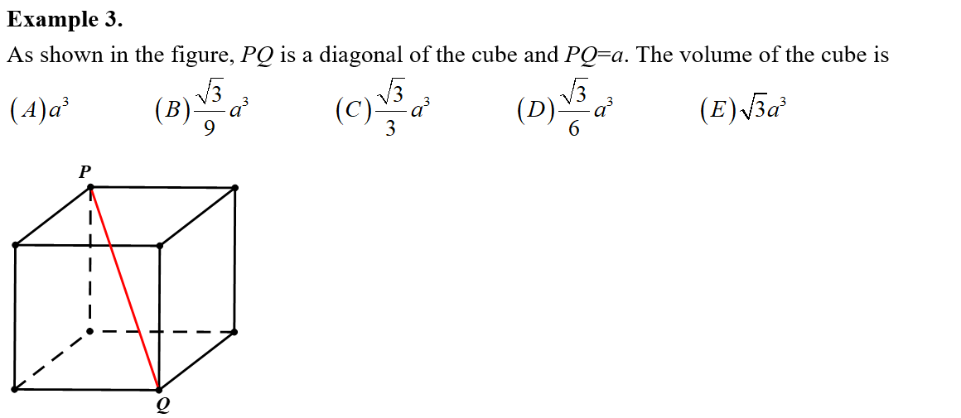
Example

Slide 8

Example

Slide 9
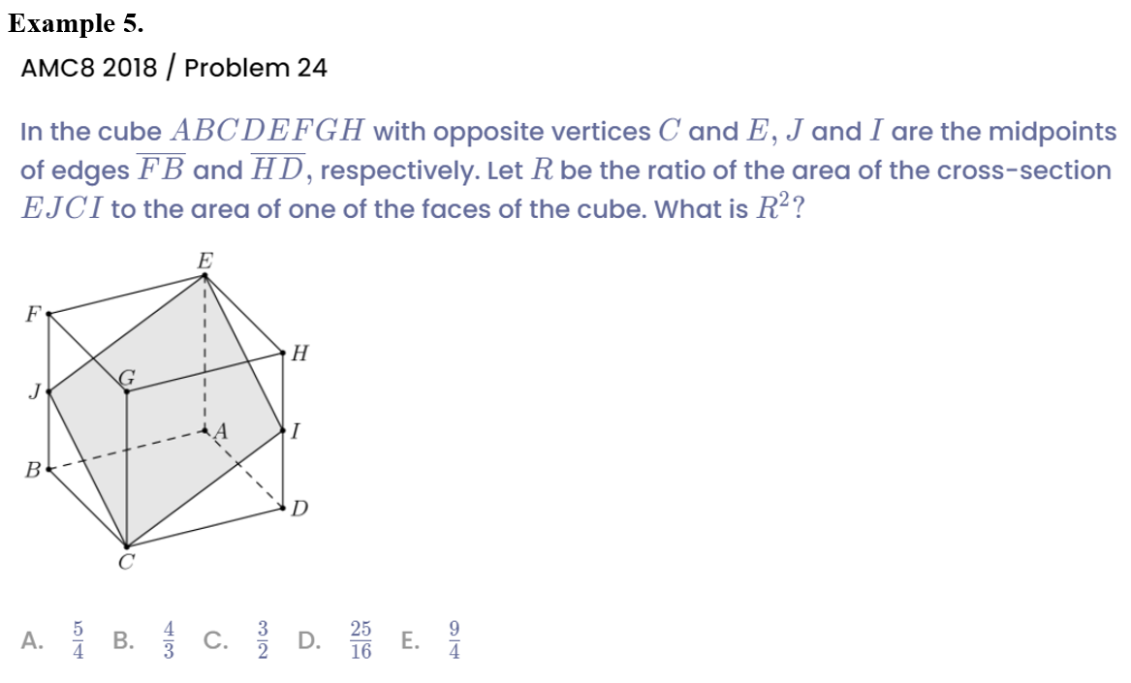
Example

Slide 10
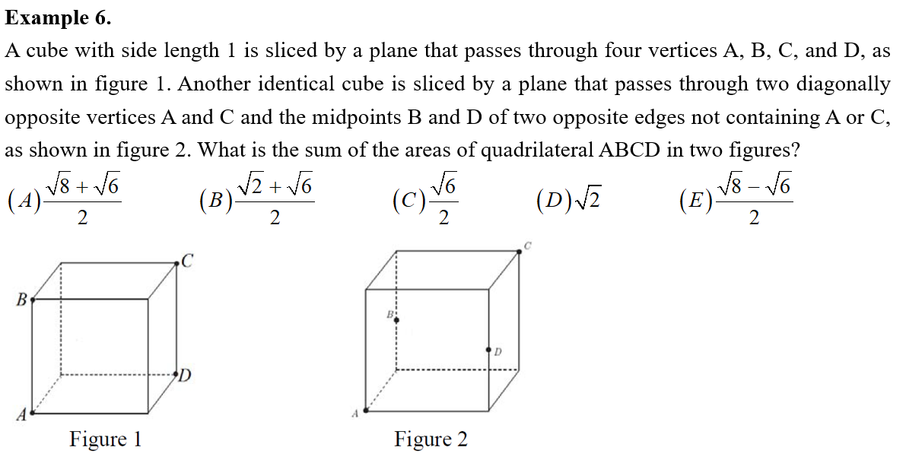
Example

Slide 11
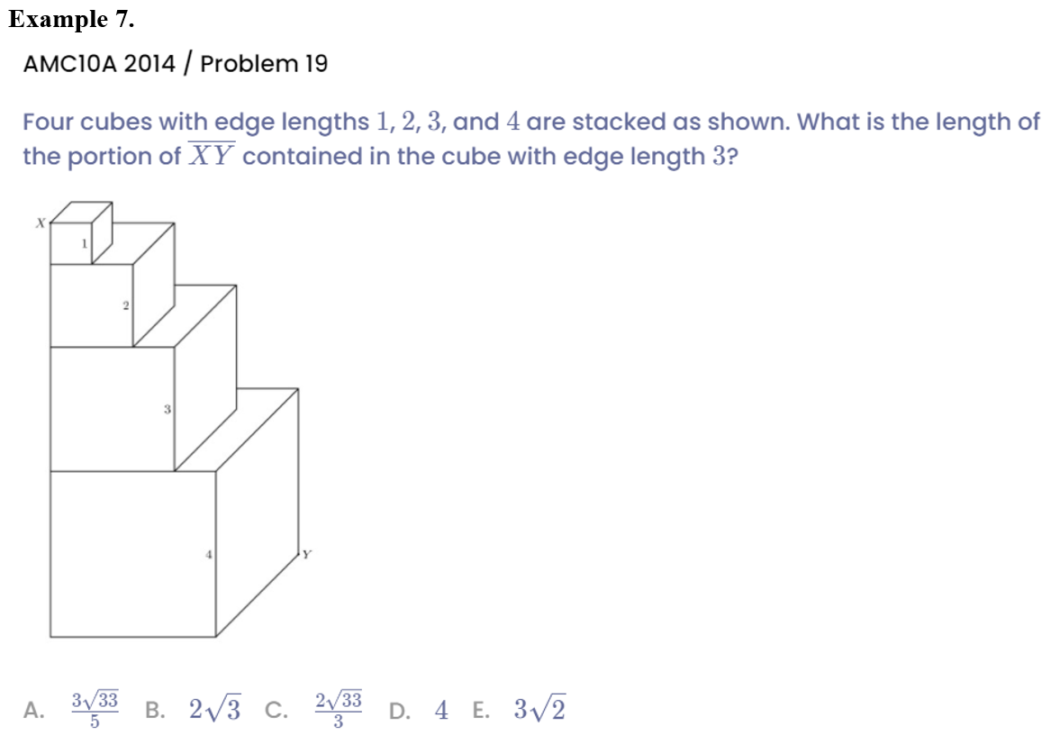
Example

Slide 12
Part 2
Rectangular & Cube

Slide 13
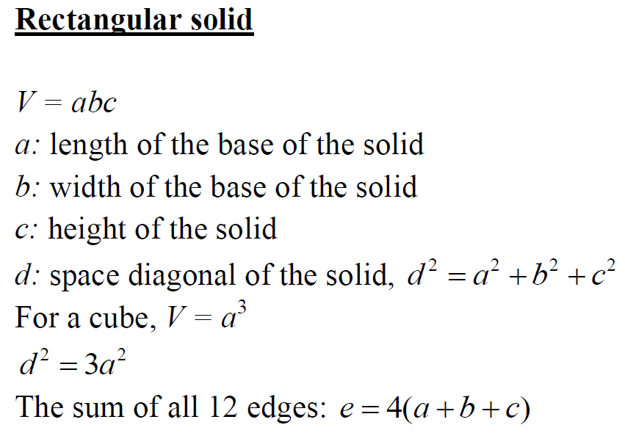
Lead in

Slide 14

Lead in

Slide 15
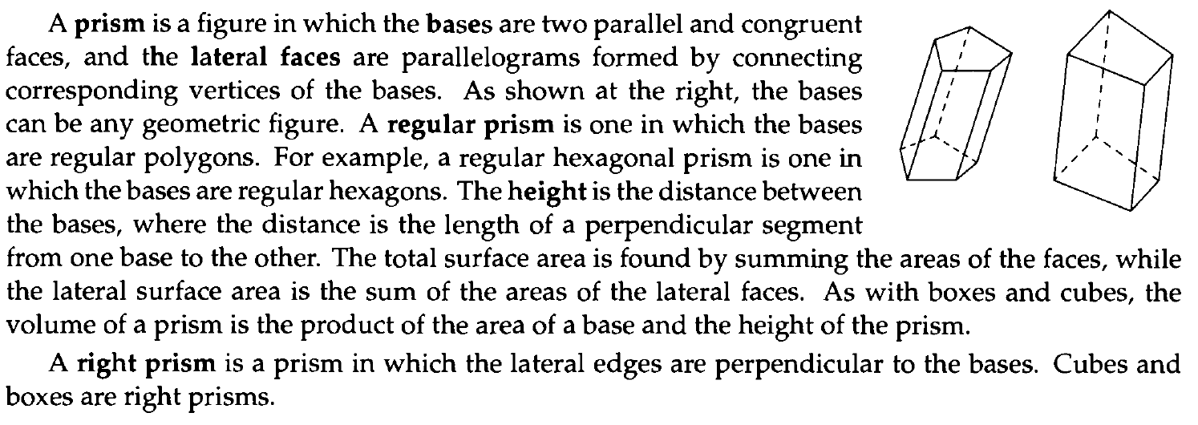
Lead in

Slide 16

Example

Slide 17

Example

Slide 18

Example

Slide 19
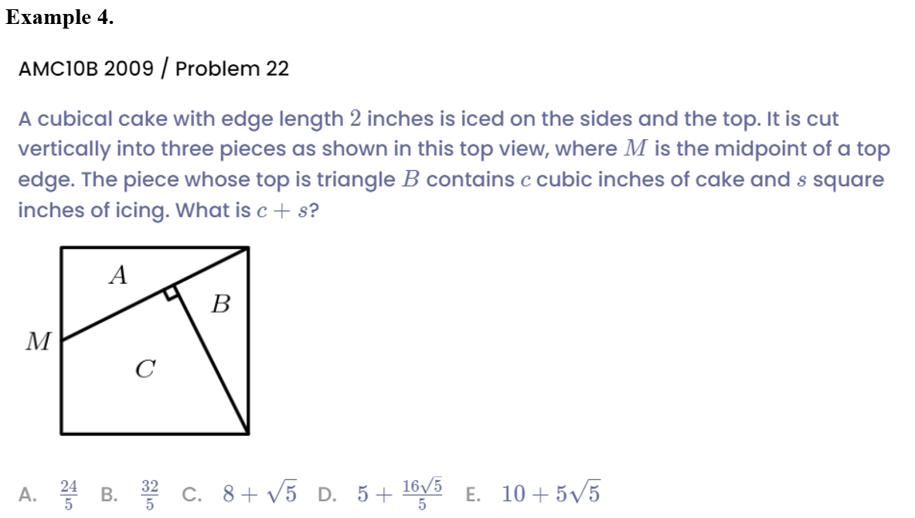
Example

Slide 20

Example

Slide 21

Example

Slide 22
Part 3
Cylinder & Cone

Slide 23
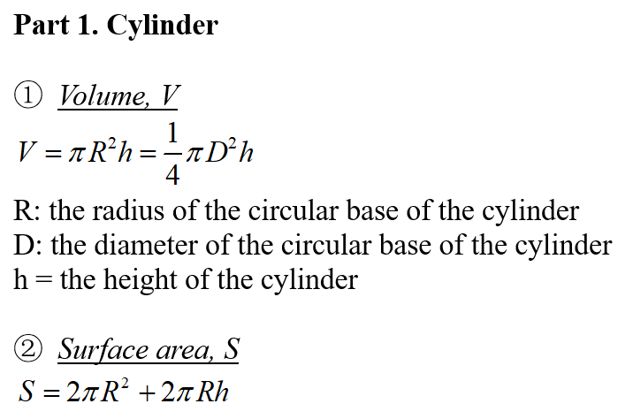
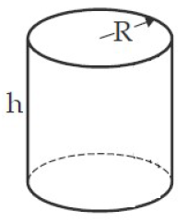
Lead in

Slide 24
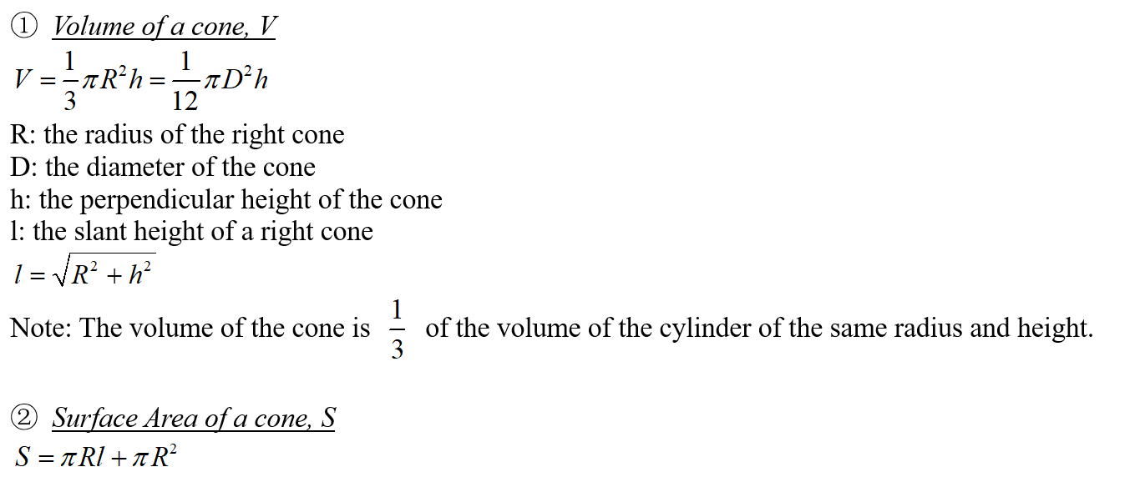
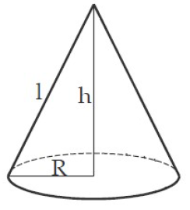
Lead in

Slide 25
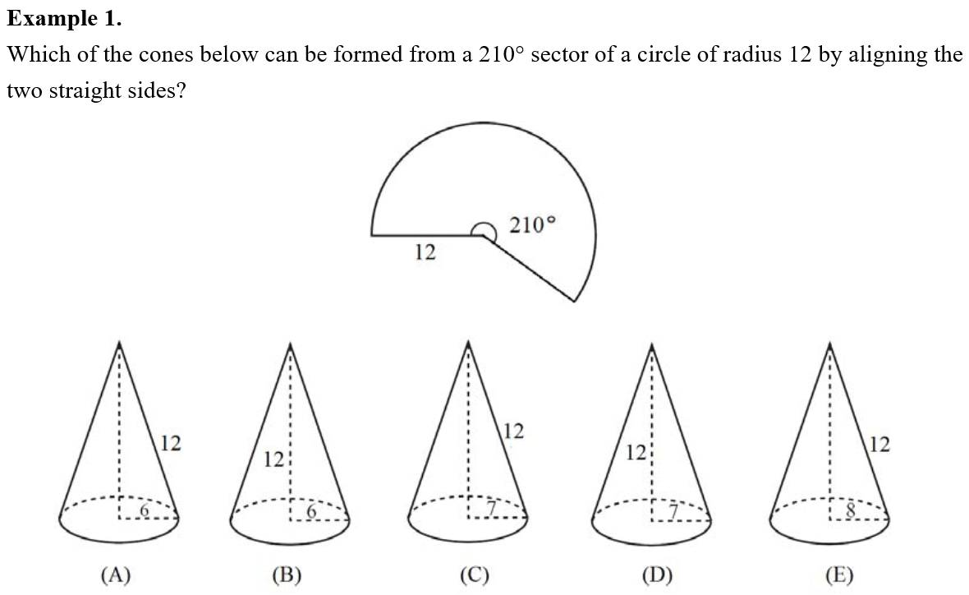
Example

Slide 26

Example

Slide 27

Example

Slide 28

Example

Slide 29
See You Next Time!

